Slide 1


Actuate E-Report Designer Pro
Understanding the Design Environment

Slide 2
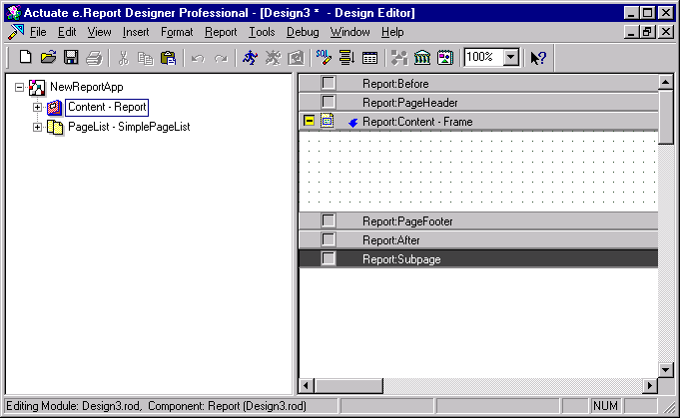
E-Report Designer Pro

Slide 3
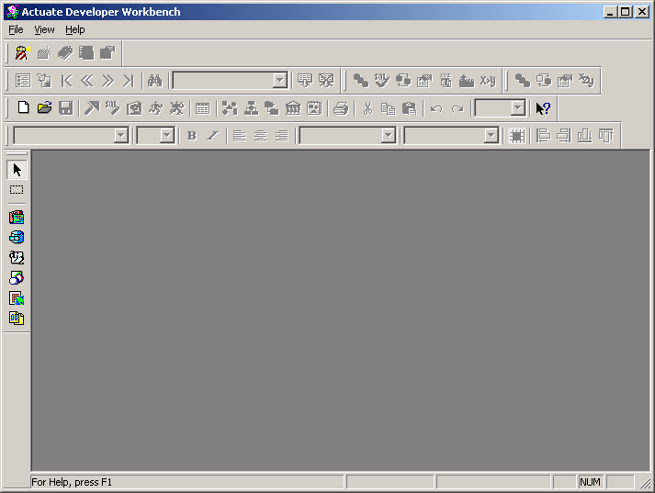
Application window
Title bar
Menu bar
Tool bars
Component Palette
Status bar

Slide 4
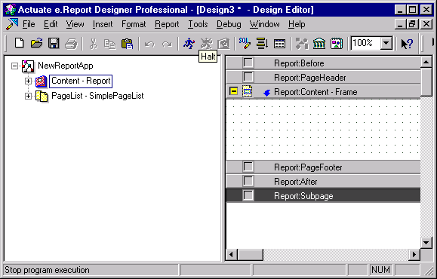
Design Window
Structure Pane
Layout Pane

Slide 5













Palettes

Slide 6

Actuate Developer Workbench
In ERD Pro click
  Menu->View->Toolbars->Component Palette
Structure
Pages
Data
Drawing/Graphics
Controls

Slide 7

Click on Structure Palette
Frame
Report Section
Report component
Group Section
Sequential Section
Conditional Section
Parallel Section

Slide 8

Actuate Developer Workbench
Click on Data
Data Row
Connection Component
Database Source Component
Data Filter

Slide 9

Actuate Developer Workbench
Click on Controls
Graph Control
Label Control
Floating Point Control
Text Control
Integer Control
Data-Time Control
Currency control

Slide 10

Actuate Developer Workbench
Click on Drawing/Graphics
Browser Scripting Control
Line Control
OLE Container Control
Ellipse Control
Rectangle Control
Image Control

Slide 11

Actuate Developer Workbench
Click on Pages
Page Number Control
Page List Control
Flow Control
Page Control
Subpage Control

Slide 12
Actuate Developer Workbench
Navigation Controls
Search
Table of Contents
Goto Page
Last Page
First Page
Previous Page
Next Page

Slide 13
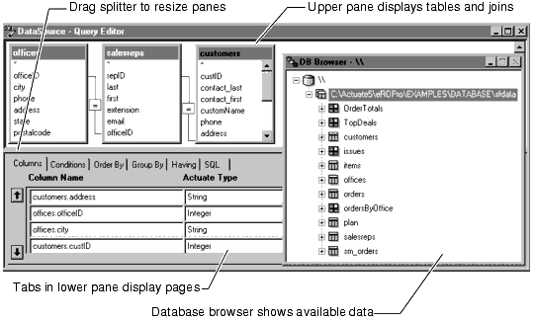
Query Editor

Slide 14
Query Editor
Upper Pane : Selecting the tables and joins.
Columns : to select or define computed columns.
Conditions : Specify the criteria to retrieves the data from the database.
Order by: Specify the sort order.
Group by: Specify aggregate rows, which total data from a group of rows.
Having: Specify criteria for selecting specific aggregate rows.
SQL: View the SQL Select statement.

Slide 15
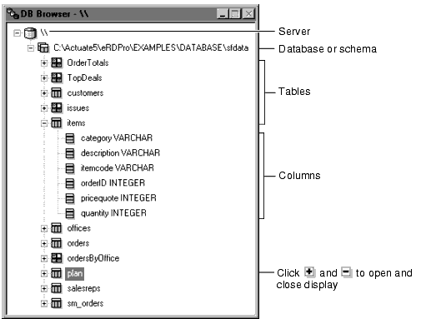
Database Browser
Displays the available databases, tables, and columns managed by the DBMS to which Actuate is connected.

Slide 16
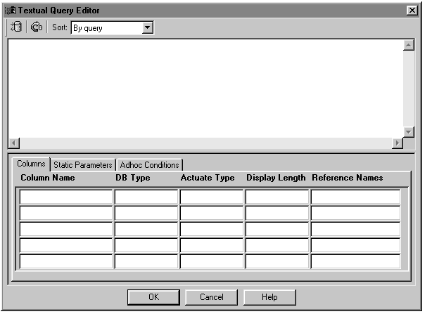
Textual Editor
A textual tool for writing SQL SELECT queries.
Provides a way to define SQL Statement without overriding AFC Methods.

Slide 17
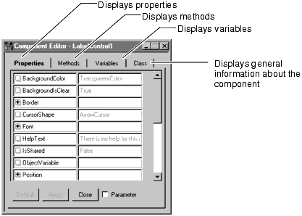
Component Editor
Used in getting information about any component in the report design.
Viewing and Setting property Values.
Creating or Editing Variables.
Creating new methods or overriding inherited methods.

Slide 18
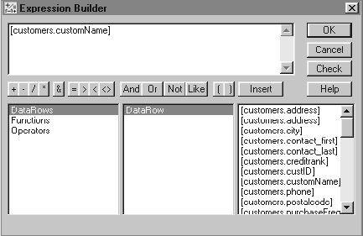
Expression Builder
Used to construct value expression for properties of the component.

Slide 19
Information about the Class
Choose the Class tab to view the General information about the class.
Identifies the class name, the class from which the selected class is derived.
Scope of the Class and the module in which it resides.
Any comments provided by the developer.
Private Checkbox.

Slide 20
Variables
Choose the Variable tab to manipulate the variables for a component.
The Name should be a valid name (Can be a Array Name or a multi Array).
Choose the Variable Data Type and can be the following.
  String, Integer, double or data type we define.
  Actuate Foundation Class.
  Any Declared Class.
Select Storage Type (Instance or Static).
  Static – Same for All the instance for the class.
  Instance – Different for different instance for the class.

Slide 21
Variables
Visibility of the Variable (Depends on the storage Type).
  Essential Property.
  Parameter.
  Private.
  Property.
  Public.
Externally Defined Data Type should be selected if the data type is user-defined.

Slide 22
Working with Methods
Methods significantly affect the component.
Confirm whether creating new methods is the best choice.
Actuate supports function overloading.
Actuate allows duplicate method name but the methods should be in different scope.
Overriding inherited methods are allowed.

Slide 23
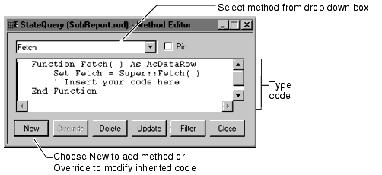
Method Editor
To Write Actuate Basic Code in Methods.
A method is a Function or a procedure associated with a component.

